Slide 1

E-Commerce Sales & Customer Analytics
GROUP 2 · DATA ANALYTICS CASE STUDY
A full-cycle data analytics project — from raw data cleaning to business insight, SQL validation, statistical analysis and an interactive dashboard.
TEAM
TOOLS USED
Adithyan PS · Bency Bobas · Bibin T S · Dalu Alex
Excel · Power Query · MySQL · Python · Power BI
Prepared for NeST Digital Academy
Notes:
Welcome slide. Introduce the team and the project scope: a complete analytics case study covering data cleaning, business analysis, SQL, Python and a Power BI dashboard, built on an 18,000-order e-commerce dataset.

Slide 2
PROJECT OVERVIEW
Problem Statement
Objectives :
Data cleaning & validation
Sales & customer analysis
Product & category performance
Location & segment analysis
Discount impact analysis
Dashboard & KPI development
Data-driven recommendations
The e-commerce company has data spread across multiple files, making it difficult to understand sales performance, customer behavior, product performance, and discount effectiveness. The project aims to clean, analyze, and visualize the data to identify key business insights and support better decision-making.
The dataset contains 4 interconnected e-commerce tables covering 4,010 customers, 18,020 orders, 30 products, and 8 locations across India for 2025. After data cleaning, 4,000 customers and 18,000 orders were used for analysis
Analysis performed using Excel, SQL and Python; results presented through an interactive Power BI dashboard.
E-Commerce Sales & Customer Analytics · Group 2
02

Slide 3
DATASET
Dataset Overview
Dataset / Table | Records | Key Information
Customers | 4,010 → 4,000 | Customer ID, Age, Gender, City, Signup Date, Customer Segment
Orders | 18,020 → 18,000 | Order ID, Customer ID, Product ID, Order Date, Quantity, Sales, Discount, Status, Payment
Products | 30 | Product ID, Product Name, Category, Unit Price, Stock
Locations | 8 | Location ID, City, State, Region, Market Size
Total | 4 Tables | E-commerce transactions across 8 Indian cities
Period | 2025 | January–December 2025
E-Commerce Sales & Customer Analytics · Group 2
03

Slide 4
Dataset Cleaning Summary
Dataset | Issue Found | Resolution
customers | 10 duplicate rows (4,010 → 4,000) | Removed using Power Query Remove Duplicates
customers | “Regular” / “regular” case inconsistency in Customer_Segment | Standardized to Title Case (3 clean values: New, Regular, Premium)
orders | 20 duplicate rows (18,020 → 18,000) | Removed using Power Query Remove Duplicates
orders | 25 blank Net_Sales values | Recomputed using Net_Sales = Gross_Amount − Discount + Shipping_Fee (formula held exactly for all non-blank rows)
orders | “Completed” / “completed” case inconsistency in Order_Status | Standardized to Title Case (3 clean values: Completed, Cancelled, Returned)
orders | Order_Date stored as text | Converted to proper Date type
products | 5 products with invalid Unit_Price = (-50) | Recovered true price from Gross_Amount/Quantity (see Section 5.3) — not simply the absolute value
locations | None found | No cleaning required

Slide 5
Overall Sales & Category Performance
SALES PERFORMANCE
TOTAL SALES
TOTAL ORDERS
AVG ORDER VALUE
₹10.05 Cr
18,000
₹5,580.63
Sales by Category
Beauty
₹2.34 Cr
Fashion
₹2.30 Cr
Electronics
₹1.95 Cr
Home & Kitchen
₹1.87 Cr
Sports
₹1.59 Cr
Top products: Moisturizer ₹49.78L · Shampoo ₹49.61L · Football ₹49.27L · T-Shirt ₹48.06L · Coffee Maker ₹46.02L
E-Commerce Sales & Customer Analytics · Group 2
03
Notes:
Total sales across all 18,000 orders is ₹10,04,51,357.55 with an average order value of ₹5,580.63. Beauty and Fashion lead category sales; the top five products are led by Moisturizer and Shampoo.

Slide 6
Monthly Trend, Customer Segments & Top Cities
TRENDS · SEGMENTS · LOCATIONS
Monthly Sales Trend
Orders by Segment
Top Cities by Sales
Mumbai
₹1.36 Cr
Chennai
₹1.31 Cr
Kolkata
₹1.29 Cr
Pune
₹1.26 Cr
Regular
9,013
Delhi
₹1.23 Cr
New
6,424
Jan
Feb
Mar
Apr
May
Jun
Jul
Aug
Sep
Oct
Nov
Dec
Premium
2,563
Other cities showed relatively balanced performance.
January recorded the highest sales at ₹88.15L, while February recorded the lowest at ₹74.35L. Monthly sales fluctuated throughout the year without a sustained upward or downward trend.
E-Commerce Sales & Customer Analytics · Group 2
04
Notes:
Monthly sales show no sustained seasonal trend. Regular customers place the most orders, and Mumbai leads city-wise sales, closely followed by Chennai and Kolkata.

Slide 7
Product Popularity & Discount Impact
PRODUCTS · DISCOUNTS
Discount Depth vs Average Order Value
Top-Selling Products (by Qty)
Face Wash · Moisturizer · Running Shoes · Cricket Bat · Storage Box
Least-Selling Products (by Qty)
0%
5%
10%
15%
20%
30%
Power Bank · Sneakers · Perfume · Smart Watch · Bluetooth Speaker
AOV declines steadily as discount depth increases — from ₹5,971.73 at 0% to ₹4,462.33 at 30%.
E-Commerce Sales & Customer Analytics · Group 2
05
Notes:
Deeper discounts correlate with lower average order value, suggesting discounts attract smaller baskets rather than driving larger ones. Product demand is fairly even, with a narrow gap between the most and least popular items.

Slide 8
Cancellations & Returns
ORDER FULFILLMENT
COMPLETED
CANCELLED
RETURNED
15,797 (87.76%)
1,104 (6.13%)
1,099 (6.11%)
Cancellation Rate by Category
Sports
13.69%
Electronics
12.34%
Fashion
12.18%
Home & Kitchen
11.93%
Beauty
11.07%
E-Commerce Sales & Customer Analytics · Group 2
06
Notes:
Overall, 12.24% of orders are cancelled or returned. Sports has the highest cancellation rate at 13.69%, while Beauty has the lowest at 11.07% — worth investigating fulfillment or sizing/fit issues in Sports.

Slide 9
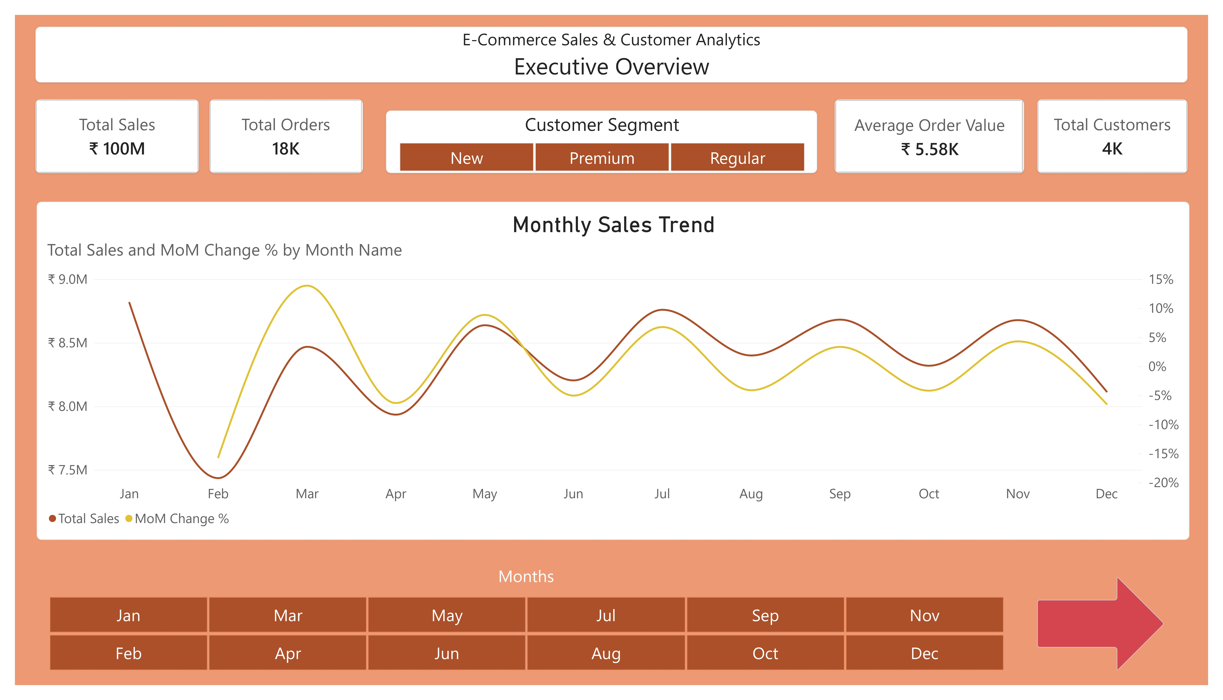
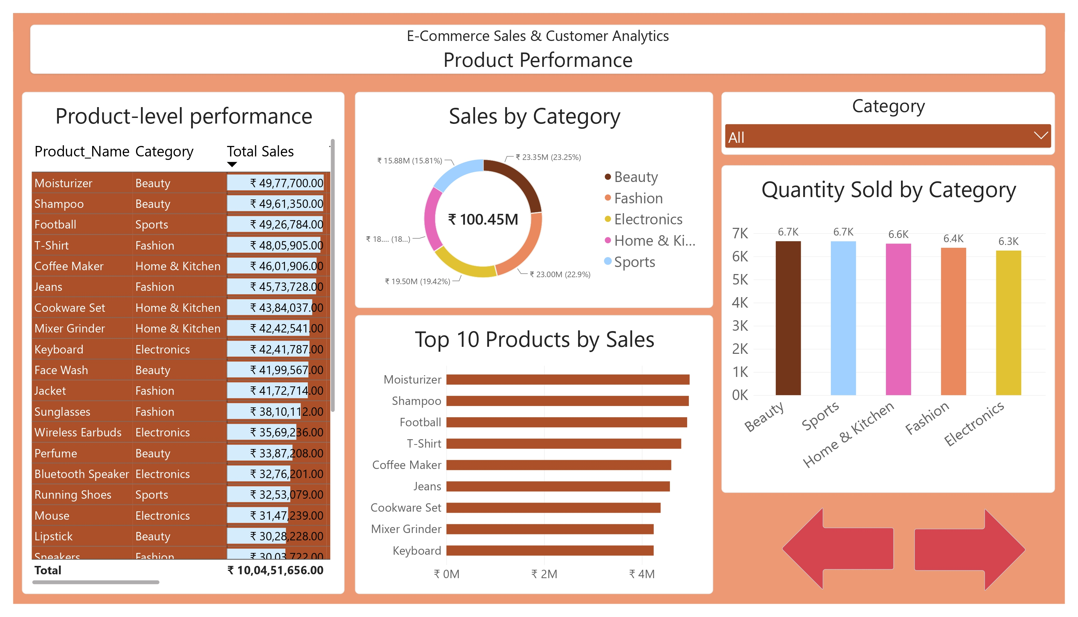
Executive Overview & Product Performance
POWER BI DASHBOARD
KPI cards surface Total Sales, Orders, AOV and Customers at a glance, with a monthly trend line below.
Drill from category share down to individual product rank, by sales value and by quantity sold.
E-Commerce Sales & Customer Analytics · Group 2
07
Notes:
Page 1, Executive Overview, gives management the headline KPIs and the monthly trend at a glance. Page 2, Product Performance, lets them drill from category share down to individual product rank.

Slide 10
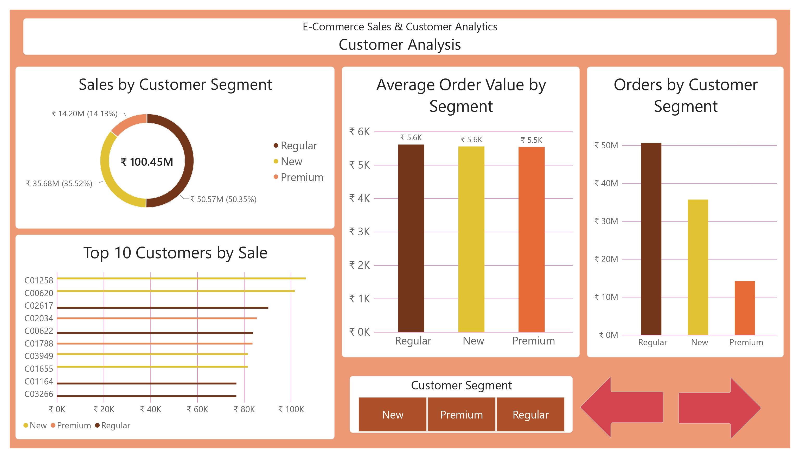
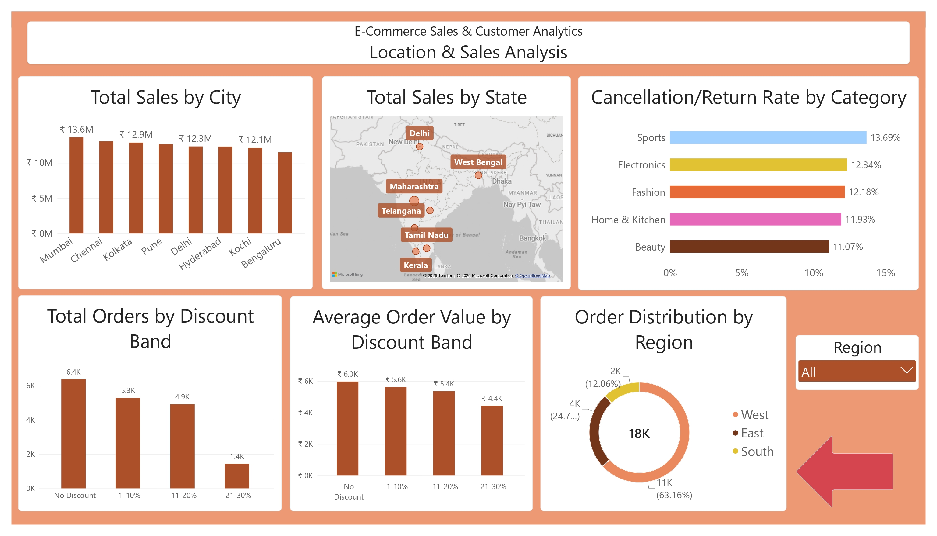
Customer & Location Analysis
POWER BI DASHBOARD
Regular customers drive the most sales and orders, mainly because the segment is larger. AOV is broadly similar across all three segments.
Mumbai leads city sales; Sports shows the highest cancellation rate; discounts and orders filter by region.
E-Commerce Sales & Customer Analytics · Group 2
08
Notes:
Page 3, Customer Analysis, breaks sales and order value down by segment and surfaces top customers. Page 4, Location & Sales Analysis, maps sales by city and state alongside cancellation rate by category and discount-band performance — all filterable by region.

Slide 11





Key Findings
INSIGHTS
₹10.05 Cr in total sales across 18,000 orders, at an AOV of ₹5,580.63
Beauty and Fashion are the top-performing categories, each above ₹2.3 Cr
No sustained monthly trend — demand stays fairly stable across the year
Mumbai, Chennai and Kolkata are the top three sales locations
Higher discount depth is associated with lower AOV.
12.24% of orders are cancelled/returned — Sports has the highest rate at 13.69%
E-Commerce Sales & Customer Analytics · Group 2
09
Notes:
These six findings summarize what the analysis uncovered: strong category and location concentration, stable demand, a discount strategy that may be eroding order value, and an elevated cancellation rate in Sports.

Slide 12
Business Recommendations
RECOMMENDATIONS
Area | Finding | Recommendation
Products & Categories | Beauty and Fashion generate the highest sales | Prioritize inventory, marketing, and promotions for high-performing categories and products
Customer Segments | Regular customers generate the highest sales | Focus on customer retention and convert New customers into Regular customers through loyalty programs
Locations | Mumbai has the highest sales, followed by Chennai | Increase marketing and inventory investment in high-potential locations such as Mumbai and Chennai
Discount Strategy | Higher discounts are associated with lower AOV | Use targeted and moderate discounts instead of excessive discounting
Underperforming Products | Sports category and Cricket Bat show relatively low sales | Review pricing, demand, product mix, and promotional strategies to improve performance
Order Value | Quantity has a strong relationship with Net Sales | Encourage larger basket sizes through bundles, cross-selling, and relevant product recommendations
E-Commerce Sales & Customer Analytics · Group 2
10
Notes:
Five concrete, data-backed actions management can take, each traced directly to a finding from the analysis.

Slide 13
From raw data to a decision-ready dashboard
CONCLUSION
The analysis transformed raw e-commerce data into actionable business insights by combining data cleaning, SQL, Python, Excel, and Power BI.
The findings show that sales are primarily driven by product demand, order quantity, customer behaviour, and location performance, while excessive discounting does not necessarily increase order value.
Management can improve business performance by strengthening high-performing products and markets, increasing customer retention, and adopting a more targeted discount strategy.
Overall, The project demonstrates how cleaned data can be transformed into actionable business decisions through Excel, SQL, Python and Power BI.
THANK YOU
Adithyan PS · Bency Bobas · Bibin T S · Dalu Alex
Notes:
Close with thanks to the team and to NeST Digital Academy, and an invitation for questions.

